Slide 1

Business Analytics II (BIS 244 – Chapter 4)
BIS 244 – Fall 2022 – Dr. Davoodi

Slide 2

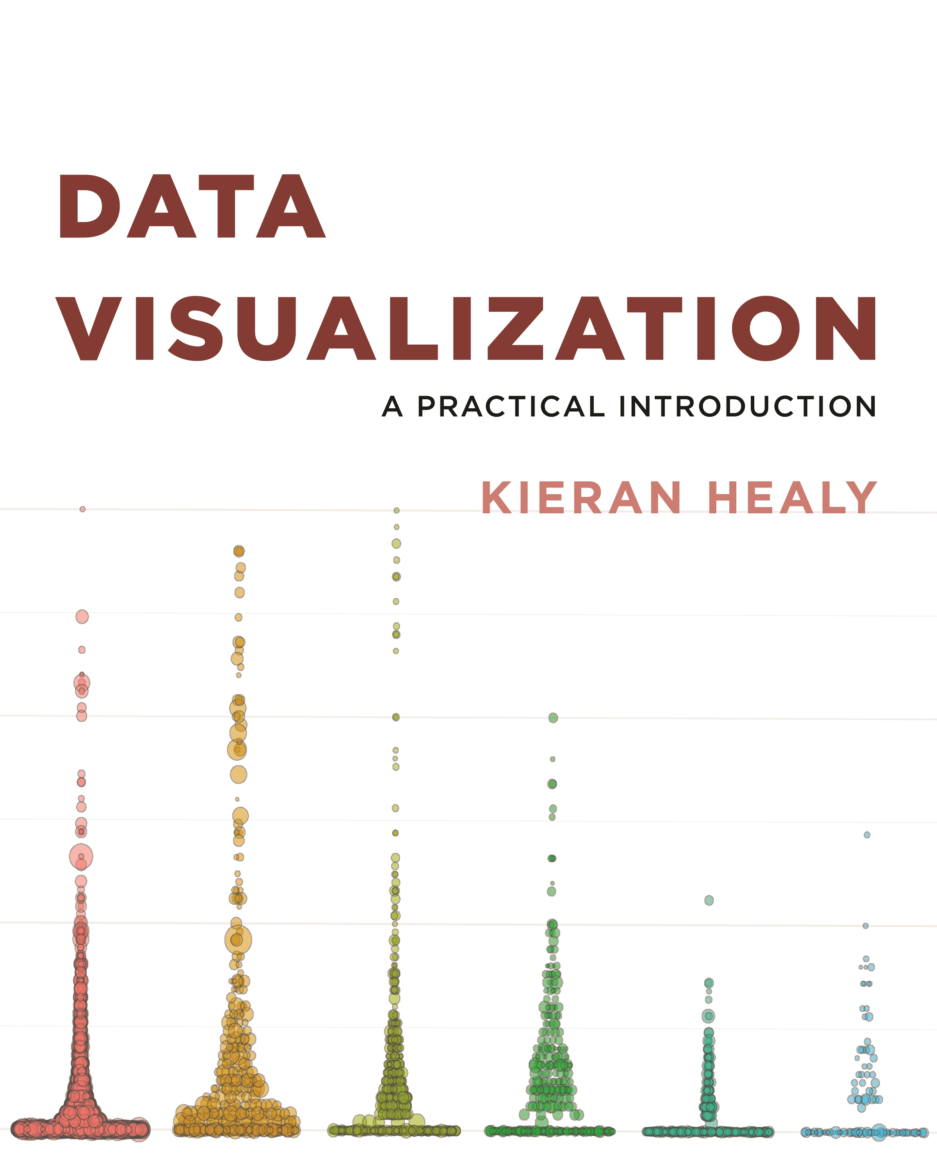
Chapter 4: Show the Right Numbers

Slide 3
Chapter 3 vs Chapter 4
Chapter 3 focus: Learn the basics of the ggplot2 package:
We need to learn ”the grammar of graphics”: Chapter 3
Chapter 3 will teach you how to use ggplot’s core functions: Introduction to the bare bone of plots
Chapter 4 focus: expanding the range of things you can do with ggplot.
learn how to make new kinds of graph.
learn some new geoms, the functions that make particular kinds of plots.

Slide 4
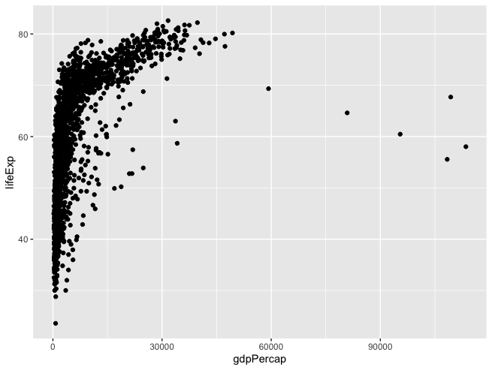
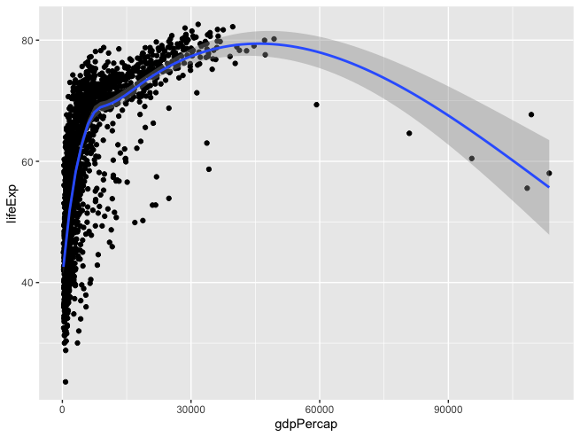
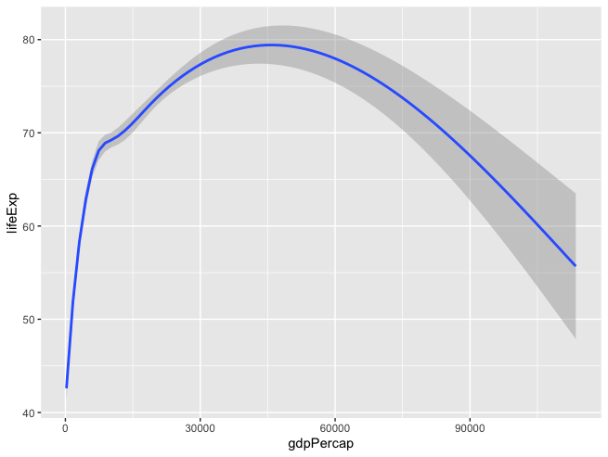
Chapter 3 review
p <- ggplot(data = gapminder, mapping = aes(x = gdpPercap, y = lifeExp))
We tell the core ggplot function what our data is.
p + geom_smooth()
p + geom_point()+ geom_smooth()

Slide 5
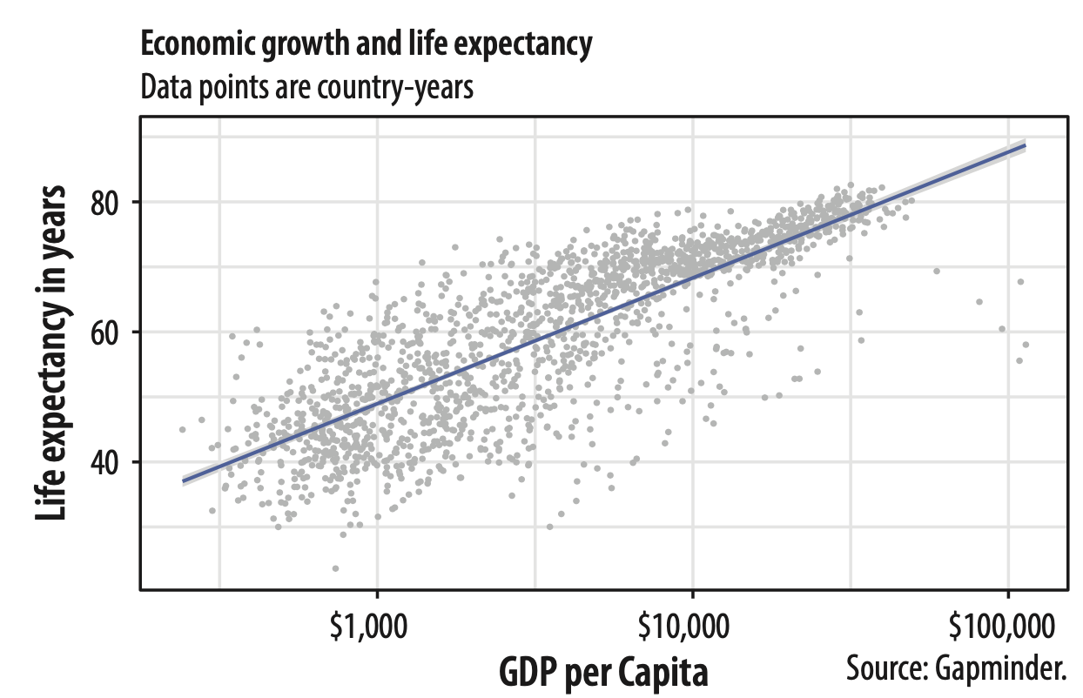
Chapter 3 review
Good labels are critical for making your plots accessible to a wider audience.
title
subtitle
p + geom_point(alpha = 0.3) +
geom_smooth(color = "orange", se = FALSE, size = 2, method = "lm") +
scale_x_log10()
y-axis label
labs(x = "x-axis label",
y = "y-axis label",
title = "Main title of the plot",
subtitle = "Sub-title of the plot",
caption = "Add caption")
x-axis label
caption

Slide 6
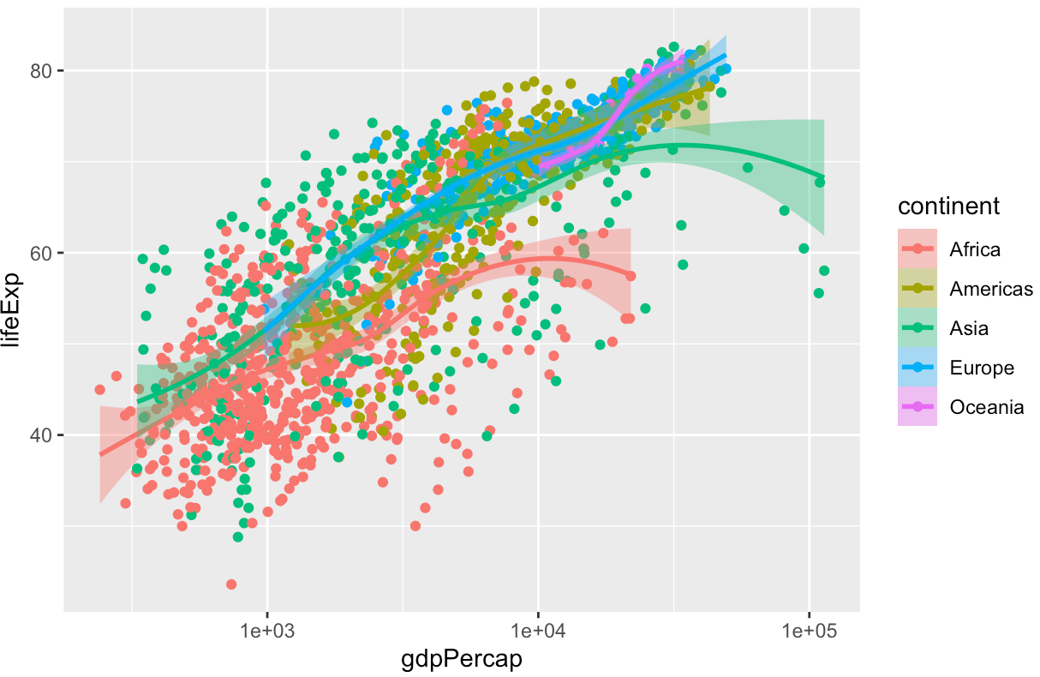
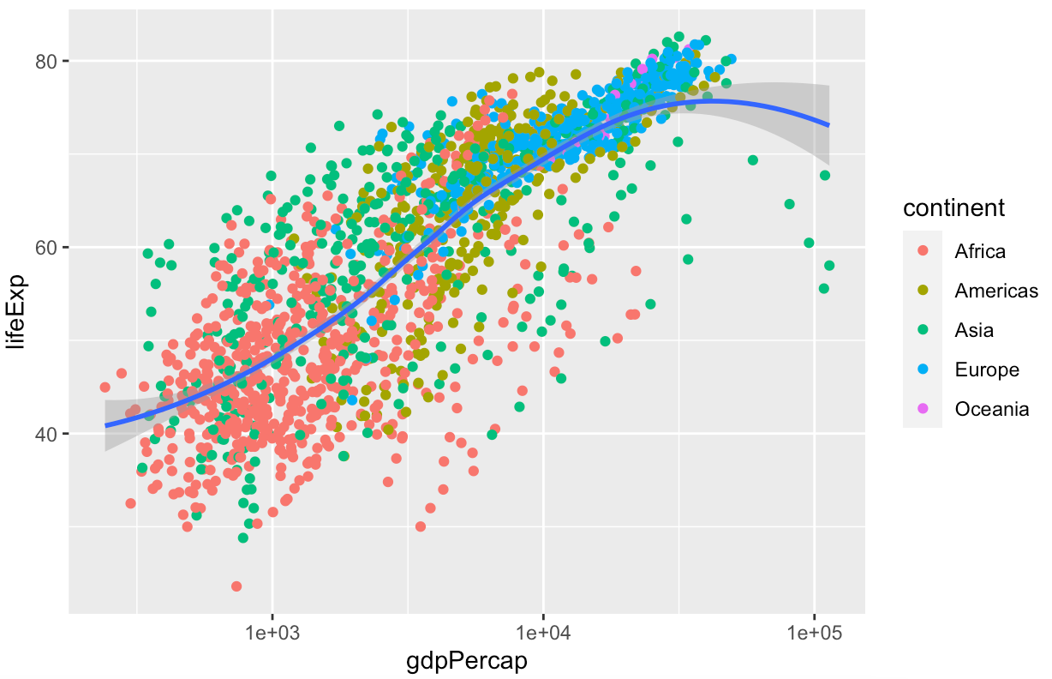
Chapter 3 review
p <- ggplot(data = gapminder, mapping = aes(x = gdpPercap, y = lifeExp, color = continent))
p + geom_point() + geom_smooth(method = "loess") + scale_x_log10()
p <- ggplot(data = gapminder, mapping = aes(x = gdpPercap, y = lifeExp))
p + geom_point(mapping = aes(color = continent)) + geom_smooth(method = "loess") + scale_x_log10()
Five separate smoothers
color is mapped to continent for the points
but single smoother
Notes:
By default, geoms inherit their mappings from the ggplot() function.
We can change this by mapping the aesthetics we want only the geom_ functions that we want them to apply to.
We use the same mapping = aes(...) expression as in the initial call to ggplot(), but now use it in the geom_ functions as well, specifying only the mappings we want to apply to each one. Mappings specified only in the initial ggplot() function—here, x and y—will carry through to all subsequent geoms.

Slide 7
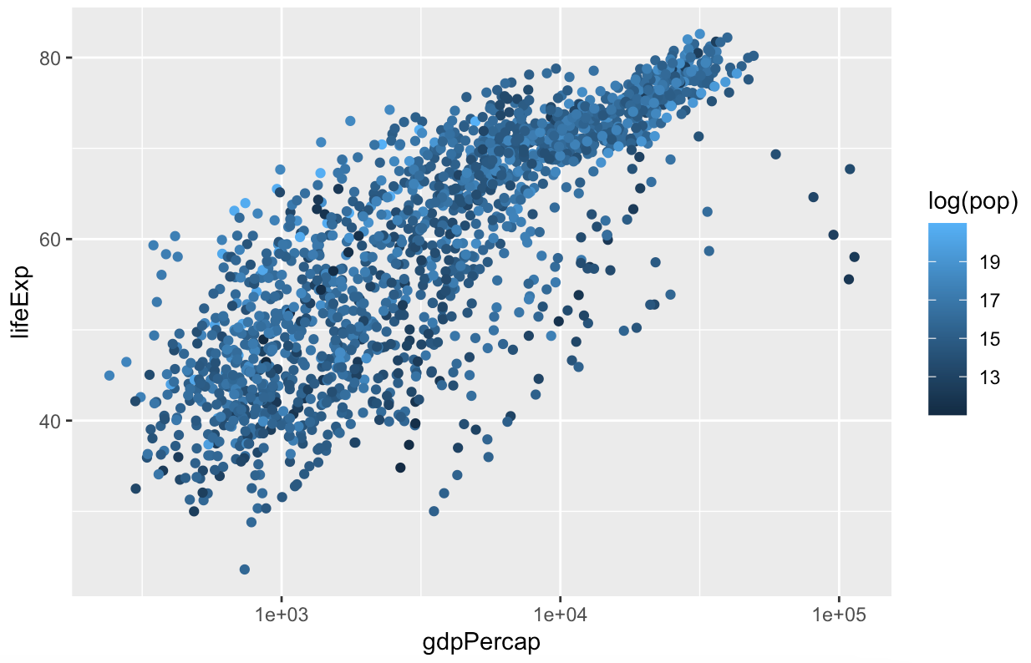
Chapter 3 review
p + geom_point(mapping = aes(color = log(pop))) + scale_x_log10()
We can map the log of each country-year’s population (pop) to color

Slide 8
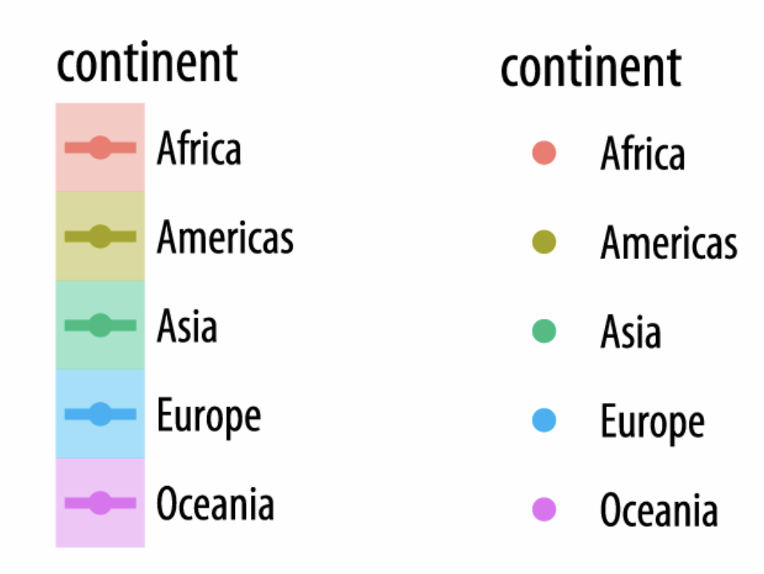
Chapter 3 review
Finally, it is worth paying a little more attention to how ggplot draws its scales.
We mapped the continent variable to both color and fill.
We then drew the figure and fitted a line for each continent.
We decided to simplify things by having only the points be colored by continent.
Mapping continuous variables to the color aesthetic (marked at intervals in the legend.)
Notes:
Because every mapped variable has a scale, we can learn a lot about how a plot has been constructed, and what mappings it contains, by seeing what the legends look like.

Slide 9
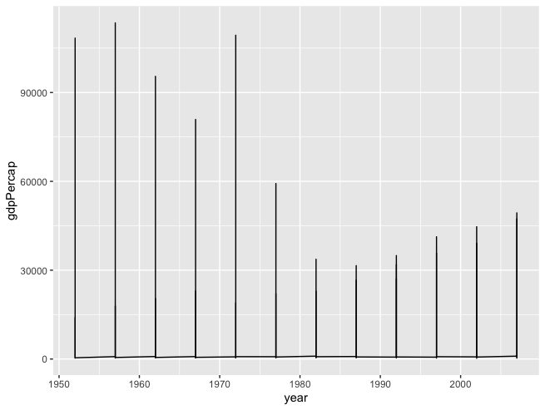
Grouped Data and the “Group” Aesthetic
p <- ggplot(data = gapminder,
mapping = aes(x = year,
y = gdpPercap))
p + geom_line()
Using a different set of x and y in gapminder
x = year,
y = gdpPercap
Something has gone wrong in the figure. What happened?
Healy_CH4.R

Slide 10
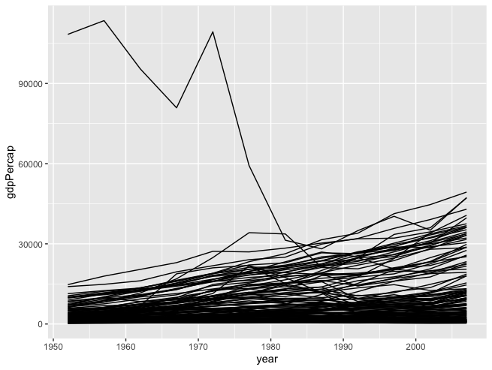
Grouped Data and the “Group” Aesthetic
The question was
We want to drew a plot for “GDP per capita over year for each country”.
Using different colors for each country and adding legend do not work.
Sometime Faceting may be an option.

Slide 11
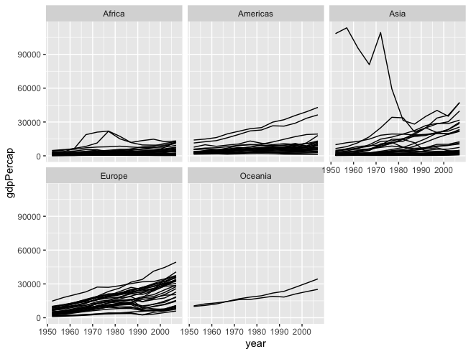
Facet to Make Small Multiples
For different continents, GDP per capita for each country has been drawn.

Slide 12
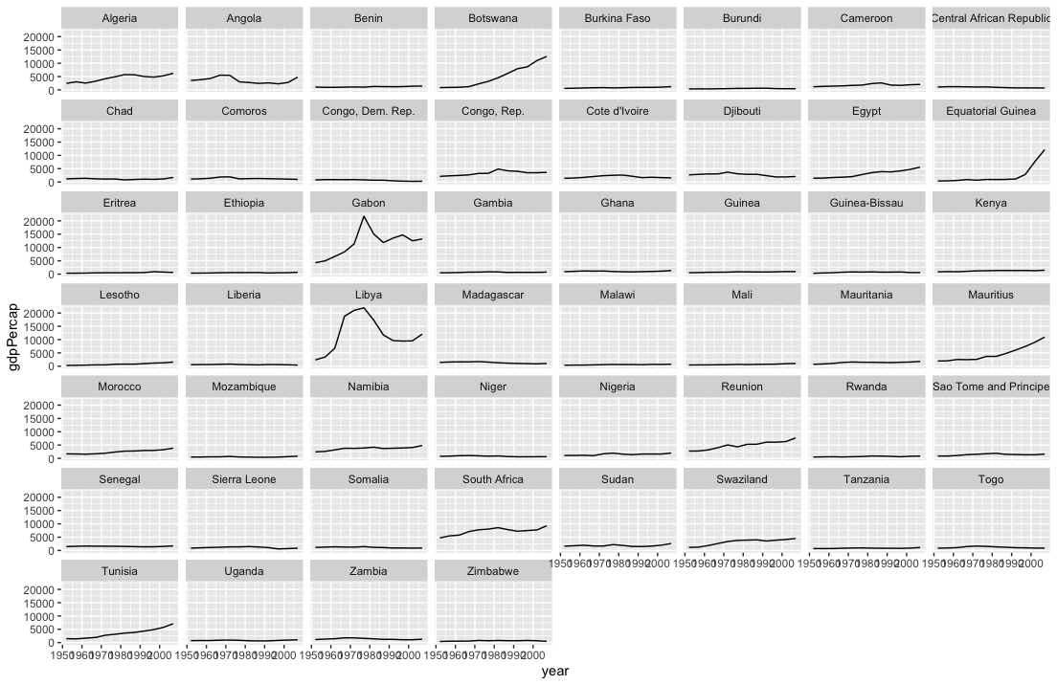
Facet to Make Small Multiples
Create a facet for African countries.

Slide 13
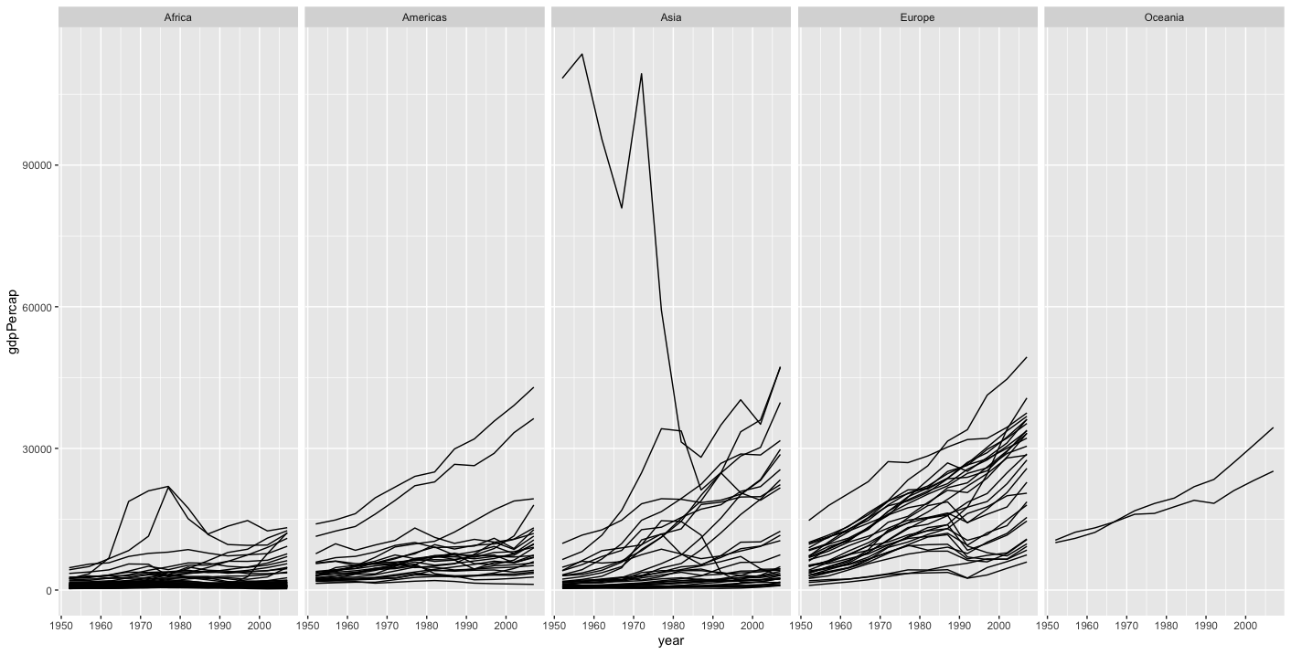
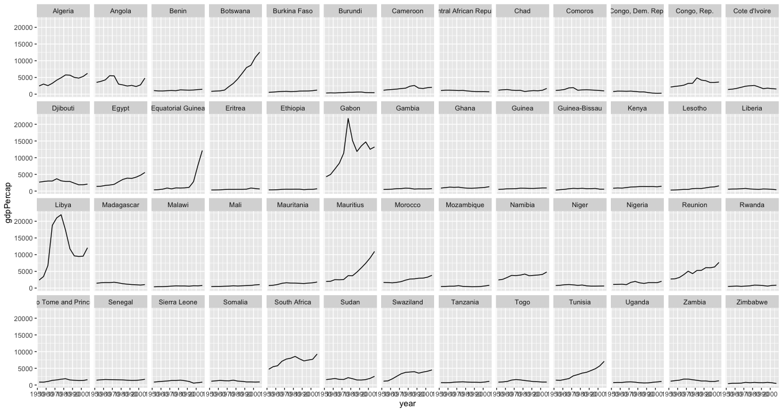
Tuning the Facet Plots
Different plots for continents by tuning ncol argument
Different plots for African countries by tuning ncol argument

Slide 14
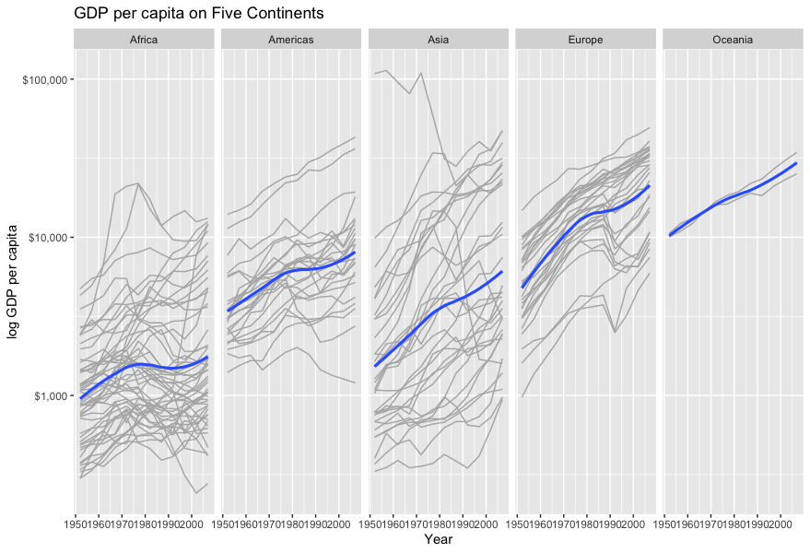
Tuning the Facet Plots
For all continents
Scaling y axis
Adding $ sign
Adding smooth function line.
Adding labels for x, y
Adding title

Slide 15
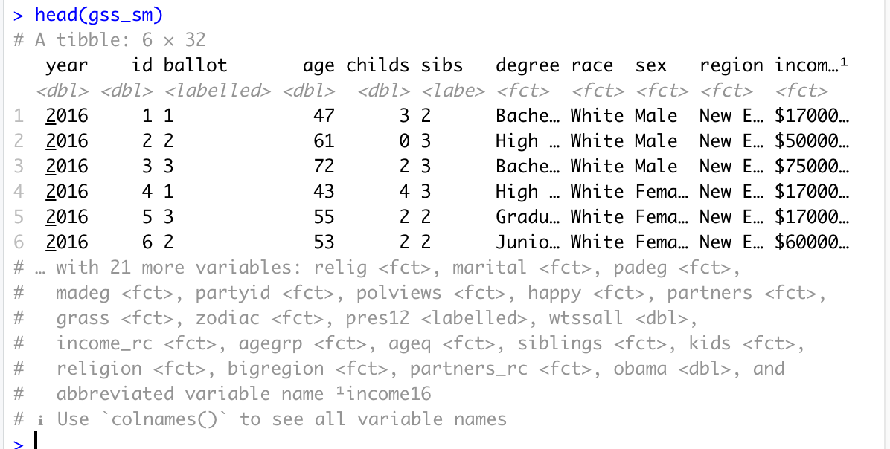
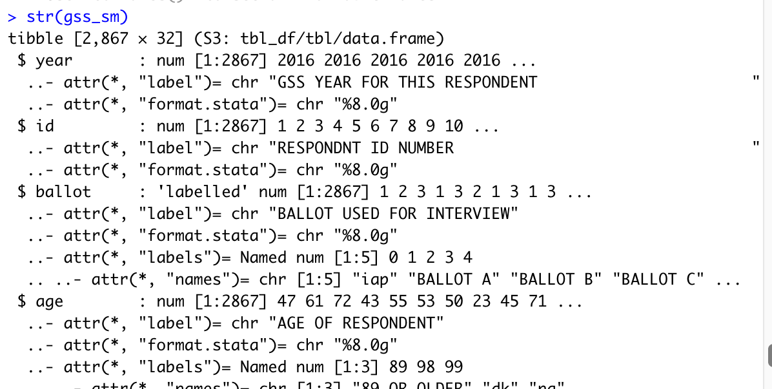
Practice: Grouping Data & Faceting
gss_sm, a small subset of the questions from the 2016 General Social Survey
The GSS is a long-running survey of American adults that asks about a range of topics of interest to social scientists.
Opinion questions may be asked in yes-or-no terms.
Many numeric measures, such as the number of children, may be treated as ordered categorical variables.

Slide 16
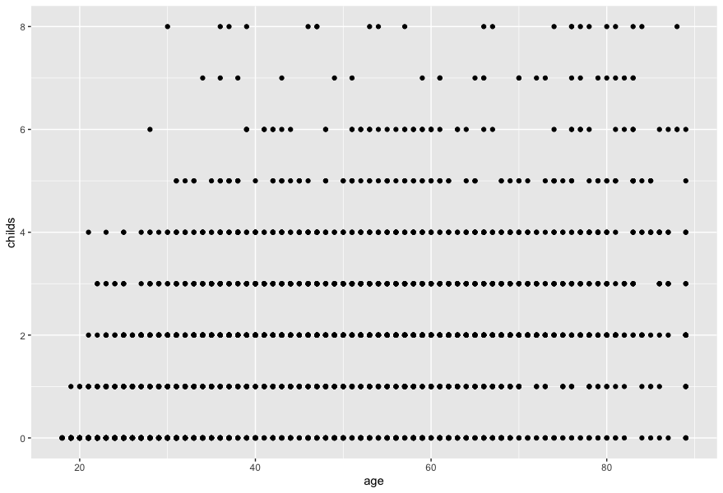
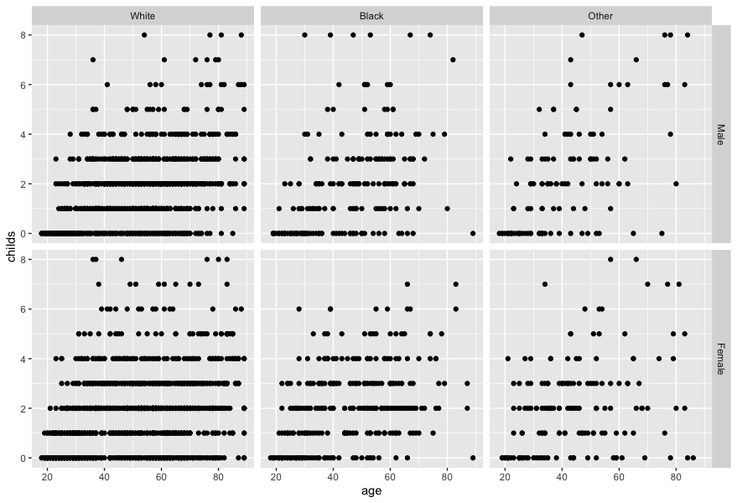
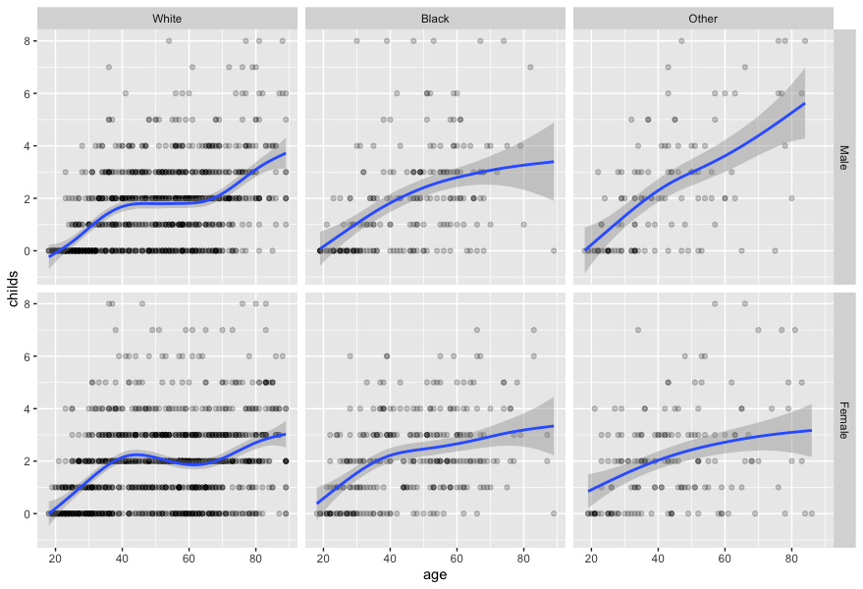
Practice: Grouping Data & Faceting
Make a smoothed scatterplot of the relationship between the age of the respondent and the number of children
facet this relationship by sex and race of the respondent.
Add smooth line for each facet

Slide 17
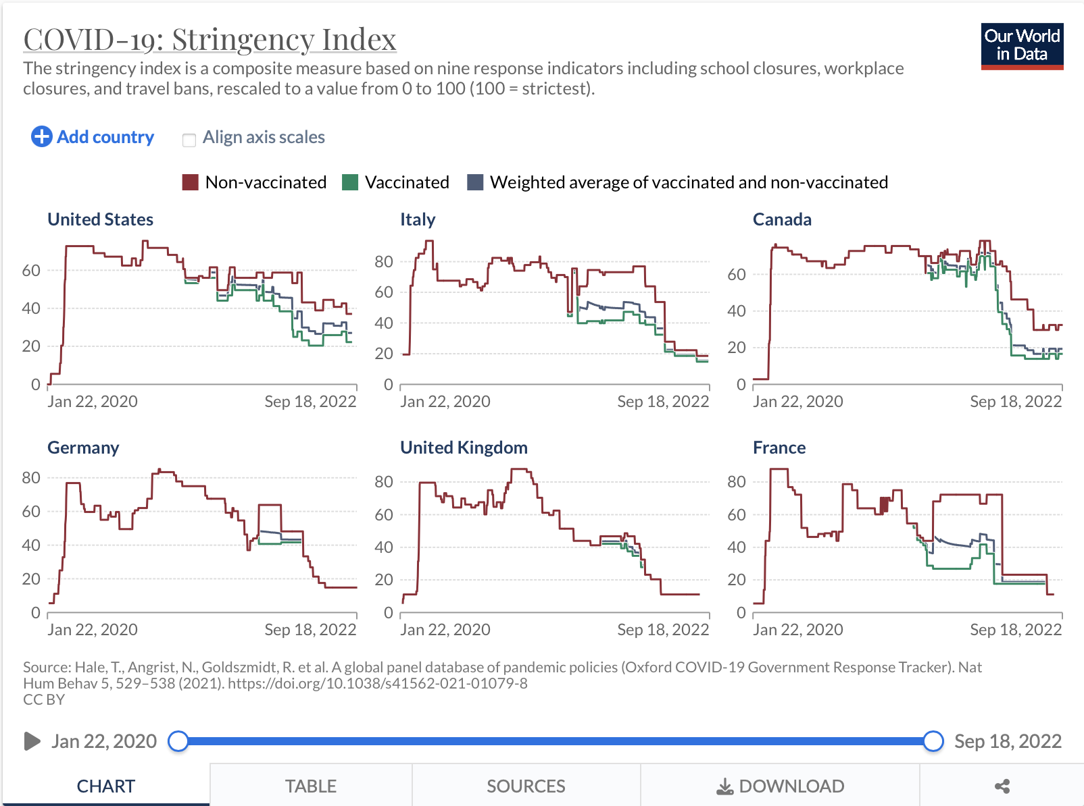
Practice: Grouping Data & Faceting
Government Stringency Index
Covid-19 dataset-- Our World in Data (OWID)
A composite measure of nine metrics.
School closures;
Workplace closures;
Cancellation of public events;
Restrictions on public gatherings;
Closures of public transport;
Stay-at-home requirements;
Public information campaigns;
Restrictions on internal movements;
And international travel controls.
https://ourworldindata.org/policy-responses-covid#government-stringency-index

Slide 18
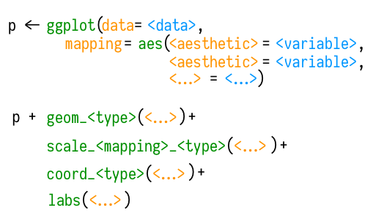
Summary
In chapter 3, we learned how to use ggplot function to draw some plots.
In chapter 4, we extended the concept to facet them and have a better understanding.
A schematic for making a plot.

